Slide 1
A Project on Housing – Price Prediction
By
Snehal Kuamwat

Slide 2
Content
Introduction
Literature
Data source
Data analysis
EDA
Data visualization
Regressor model building
Conclusion

Slide 3
Introduction
Aim- To predict housing price for the given features to maximize the prediction accuracy by employing the proposed methodology.
Concept – Data contains various information and features of the house along with target price column.
Literature – Divided in to 3 category,
1. Housing price evaluation by machine learning technique.
2. Price prediction
3. Price prediction model using machine learning algorithm

Slide 4
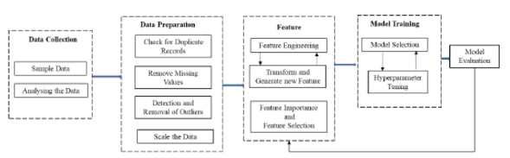
Data preparation and cleaning
Dataset in the form of CSV file, which is processed in research framework
In this model, we need to feed the available independent variables to the model will predict the possible price of houses. For designing the model the machine learning method uses multiple regression model and the tool used for coding is jupyter notebook.

Slide 5
EDA
Data Analysis
Understand the data sets
Clean the data for the missing values.
Encode the data.
Data visualization
Graphical representation of the data like graphs, maps etc. to see and understand trends, outliers, and patterns in data.
Checking the outliers, finding the correlation and skewness of data.

Slide 6
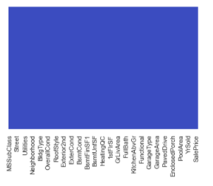
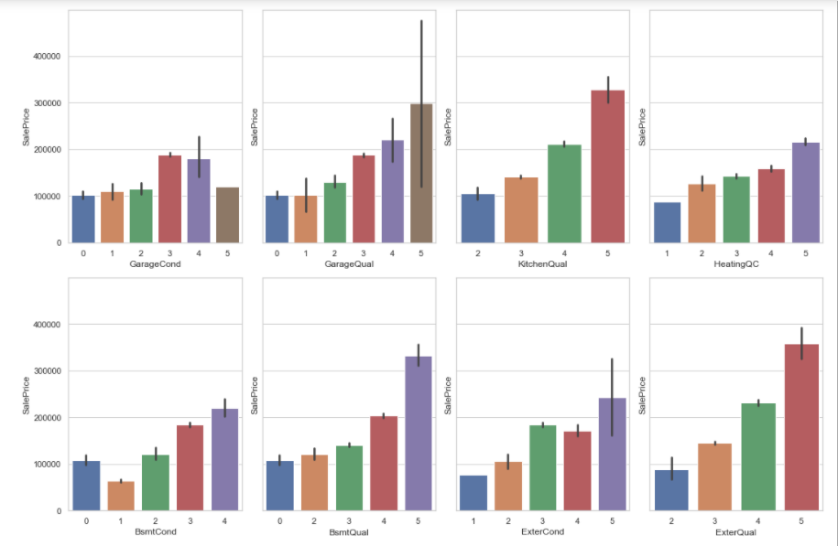
Program Codes
Code
import matplotlib.pyplot as plt
ord_cols = ['ExterQual', 'ExterCond', 'BsmtQual', 'BsmtCond', \
'HeatingQC', 'KitchenQual', 'GarageQual', 'GarageCond']
f, axes = plt.subplots(2, 4, figsize=(15, 10), sharey=True)
for r in range(0, 2):
for c in range(0, 4):
sns.barplot(x=ord_cols.pop(), y="SalePrice", \
data=df_tr, ax=axes[r][c])
plt.tight_layout()
plt.show()
Checking null values in dataset with heatmap
sns.heatmap(df_tr.isnull(),yticklabels=False,cbar=False,cmap='coolwarm')

Slide 7
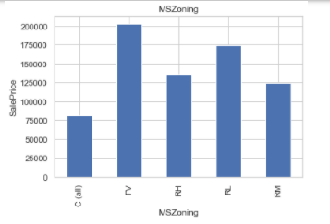
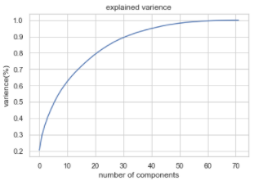
Program code
Visualzation of categorical_features
for feature in categorical_features:
data=df_tr.copy()
data.groupby(feature)['SalePrice'].median().plot.bar()
plt.xlabel(feature)
plt.ylabel('SalePrice')
plt.title(feature)
plt.show()
PCA to reduce multicollinearity
from sklearn.decomposition import PCA
pca=PCA()
pc=pca.fit_transform(x_t)
plt.figure()
plt.plot(np.cumsum(pca.explained_variance_ratio_))
plt.xlabel("number of components")
plt.ylabel("varience(%)")
plt.title("explained varience")
plt.show()

Slide 8
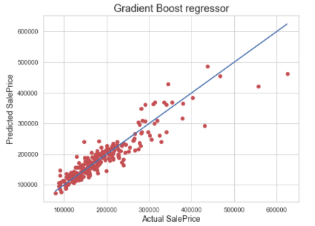
Regressor Model Building
Splitting the Dataset
As usual for supervised machine learning problems, we need a training dataset to train our model and a test dataset to evaluate the model.
Code
x_train_b,x_test_b_b,y_train_b,y_test_b=train_test_split(principal_x,y,random_state=619,test_size=0.20)
Linear Regression
Using Linear Regression we got Training r2_score is:- 81.45 and Testing r2_score is:- 81.44
Regulariztion Methods
Lasso Regression
Firstly, we will use GridSearchCV() to search for the best model parameters in a parameter space provided by us. Then we got R2 Score: 81.54 and Cross Val Score: 77.59
Ridge Regression
We got R2 Score: 81.54 and Cross Val Score: 77.59
GradientBoostingRegressor
We got R2 Score: 85.064 and Cross Val Score: 87.191
KNeighborsRegressorWe got R2 Score: 60.851 and Cross Val Score: 68.493
AdaBoostRegressorWe got R2 Score: 72.648 and Cross Val Score: 80.908

Slide 9
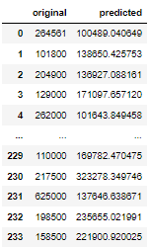
Conclusion
Predicting the house price “Gradient Boosting Regressor” is the most effective model for our Dataset with R2 Score of 85.064.And here is original and predicted houses prices

